Slide 1
Connect 4AI
By: Dustin Vuong, Yash Bhambani, Matthew Camarena, and Nathaniel Richards

Slide 2
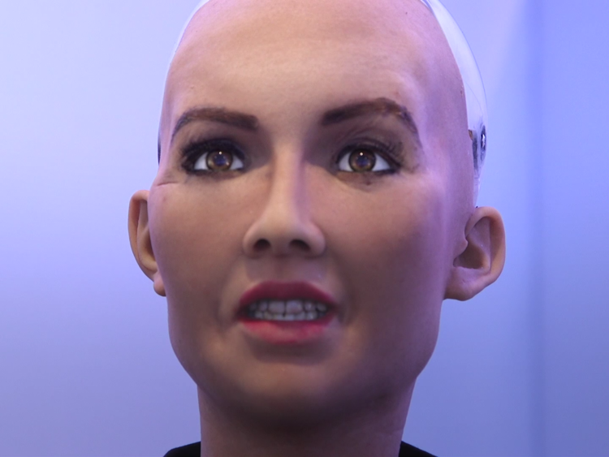
Meet The Team!
Dusin Vuong: Lead AI Programmer
Yash Bhambani: Lead Artist and Assistant Game Programmer Programmer
Matthew Camarena: Lead Game Programmer and Assistant AI Programmer
Nathaniel Richards: Assistant Game Programmer and AI Programmer

Slide 3
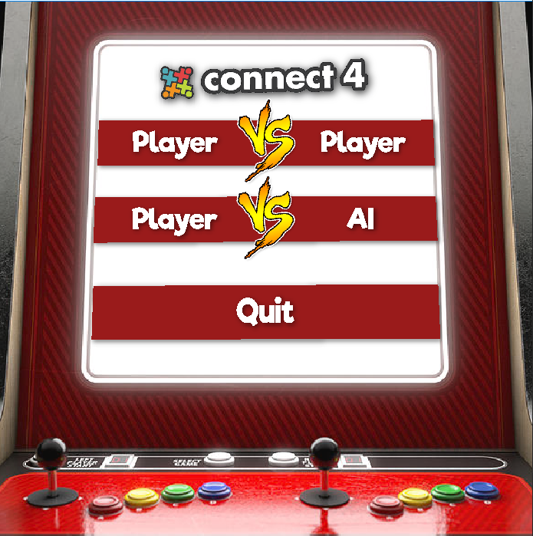
Meet our Project!
Our Project is a Connect 4 Game with Expert level AI implemented to try and beat the user.
The Connect 4AI Game is done in Python 3 with Pygame!
For fun, you can optionally play with against people!

Slide 4
Documentation
Github Link: https://github.com/nathrichCSUF/Connect4AI
Install Python 3
Run main.py from Command Line (ex: Windows → python main.py)

Slide 5
Meet our AI!
For our project, we implemented our AI with Minimax Pruning!
Minimax Pruning: decision rule used in artificial intelligence, decision theory, game theory, statistics, and philosophy for minimizing the possible loss for a worst case scenario

Slide 6
A Few Issues...
Improper counting with diagonal options
AI rarely defaults to moving to left most lane when player is about to win
Difficult to handle high depths

Slide 7
Demo Time!

